Slide 1
INVESTMENT ASSIGNMENT SUBMISSION
Subhabrata Ghosh

Slide 2
Spark Fund Investment strategy
A global asset management company called Spark Fund is looking to make investment into few companies based on the global investment trends in different sectors.
An Investment strategy needs to be planned based on global trends and few other limitations keeping in mind.
Limitations:
The investment amount will be between 5 million USD to 15 million USD
The investment will be made in the countries where one of the official language is English
Business Objectives:
To identify the best sectors and country and suitable investment type – where the most investments have been made in the past.
Extensive analysis on Investment Types , Country and Sectors.
Investment type Analysis - Analyze different investment types and find the best suitable ones based on past history and limitations
Country Analysis – Identify best countries where investments have been made in the past
Sector Analysis – Identify best Sectors to invest
T

Slide 3
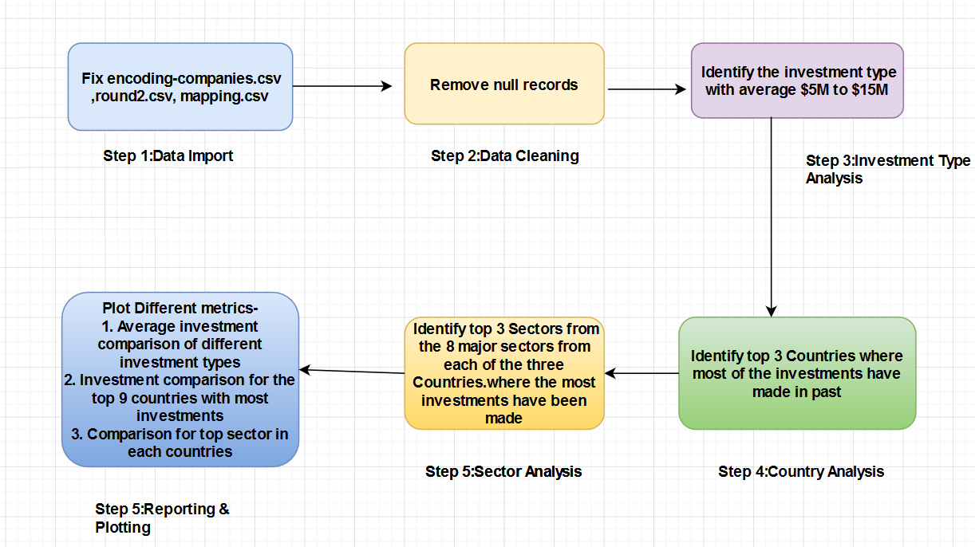
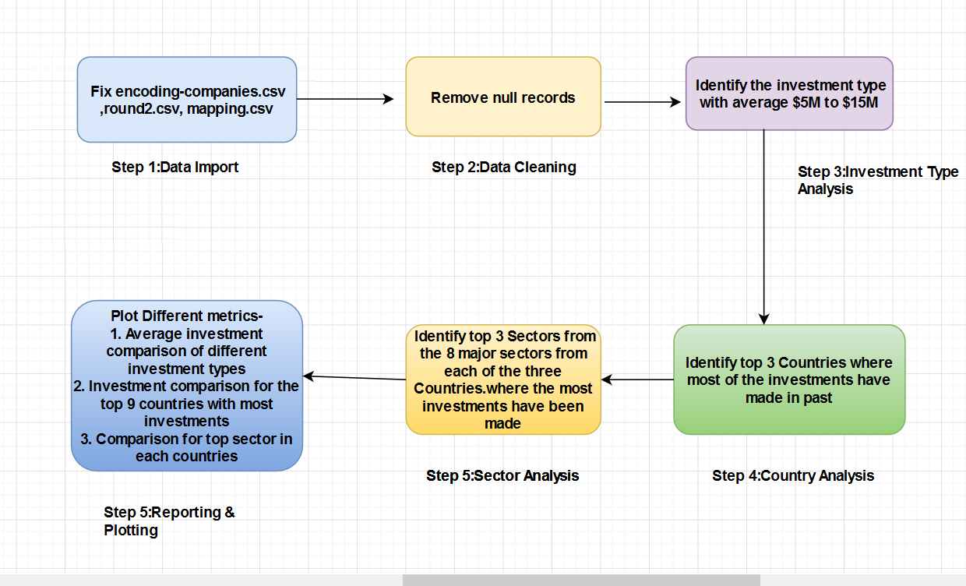
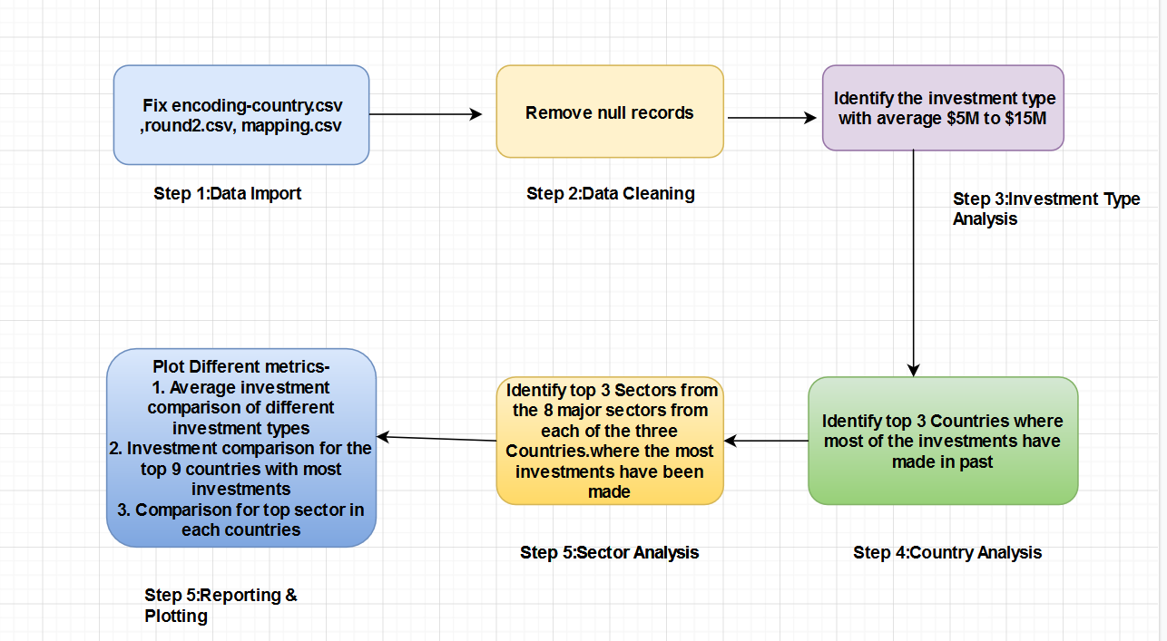
Analysis Process – Flow chart

Slide 4
Investment strategy - Analysis
This investment case study requires the following
Data Model Analysis
Investment Type Analysis
Country Analysis
Sector Analysis

Slide 5
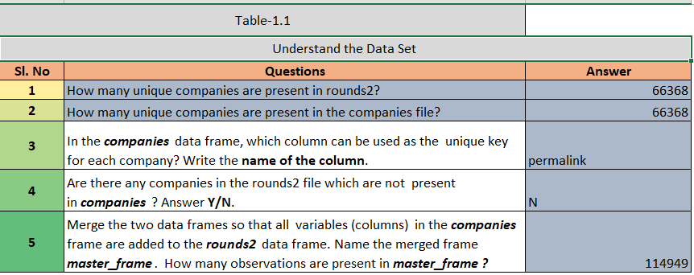
Data Model Analysis
The Data Model Analysis is a two step process
Data Import:
Import the following CSV files – companies.csv ,rounds2.csv , mapping.csv
Fix the encoding issues in the files.
Data Cleaning:
Remove NA values from the columns requires for analysis
Identify the unique column from the data frame companies - permalink
Count total companies in company data frame. – 66368
Identify total unique company_permalink column in the dataset for round2 – 66368
Merge two data sets -Company and Round into master_frame and count total records – 114949

Slide 6
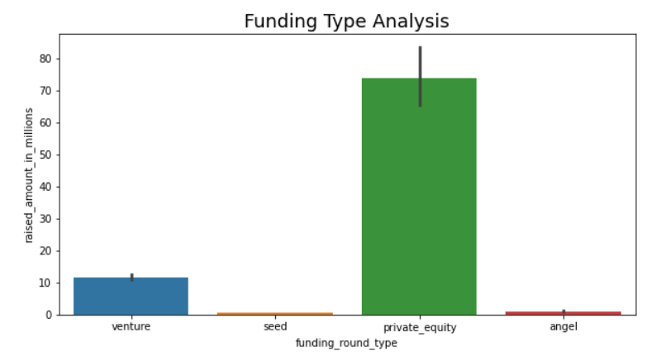
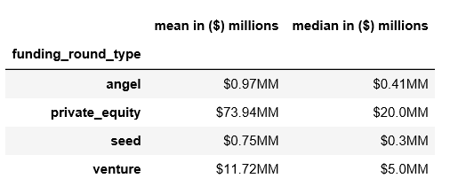
Investment Type Analysis
The goal for this investment analysis is to find the mean values for the four following investment types – venture , seed , angel ,private equity. Then identify a preferable investment type.
Observations:
Private equity is the most preferred investment type in the past with an average of $73.94 M
Our preferred investment is venture , because the average value is between $5M to $15M which is the preferred investment amount.

Slide 7
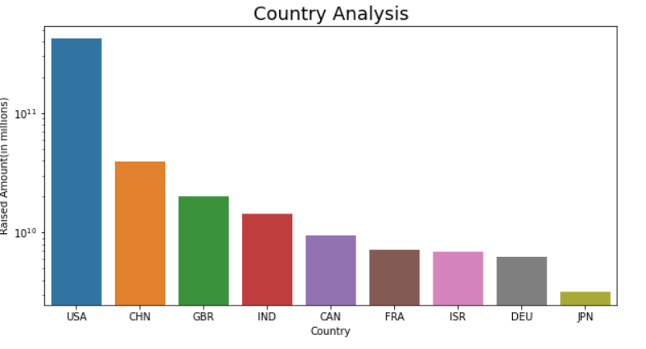
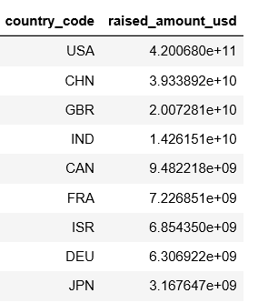
Country Analysis
The goal for this analysis is to identify the top 9 countries where the most investments have been made followed by identify the top 3 three countries with official language English.
Observations:
The top 3 preferred countries for the investment – USA , CHN,GBR
The top 3 preferred countries with English are – USA , GBR ,IND

Slide 8
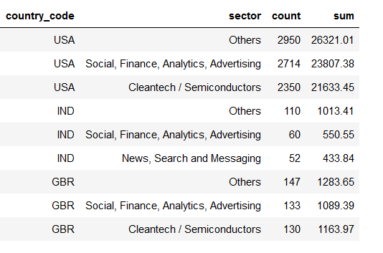
Sector Analysis (1/2)
Objective:
The objective is to map the large number of sub sector into 8 major sectors.
Find out the sector wise investments in top 3 preferred countries
Observations:
Please see the tables for the top 3 sectors for top 3 countries.

Slide 9
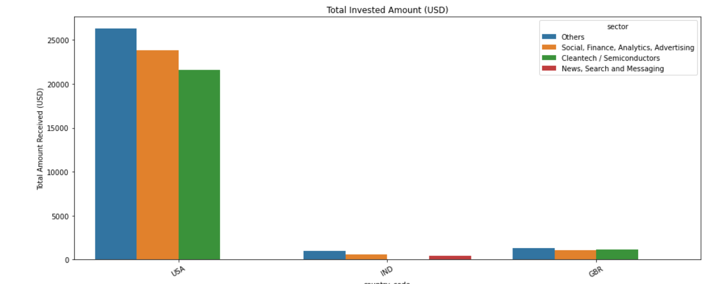
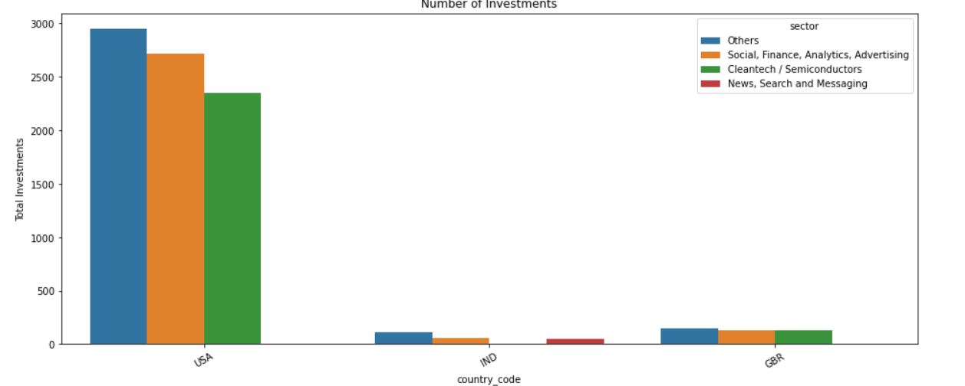
Sector Analysis (2/2)

Slide 10
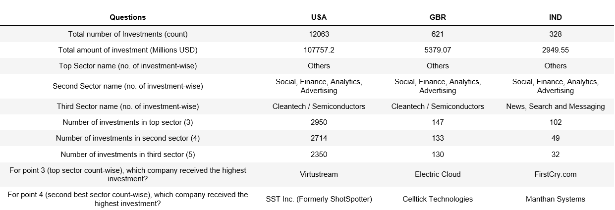
Conclusions
Based on analysis , We can conclude the following
The preferred investment type – Venture
Top three preferred countries for investment – USA , GBR ,IND

